Slide 1
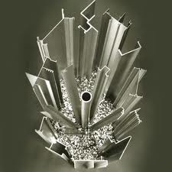
ELECTROCHEMISTRY
EXTRACTION OF ALUMINIUM

Slide 2
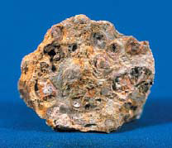
What is Aluminium Ore called?
Aluminium ore is called bauxite.
What is the Chemical Formula for Aluminium Oxide?
Al₂O₃.

Slide 3
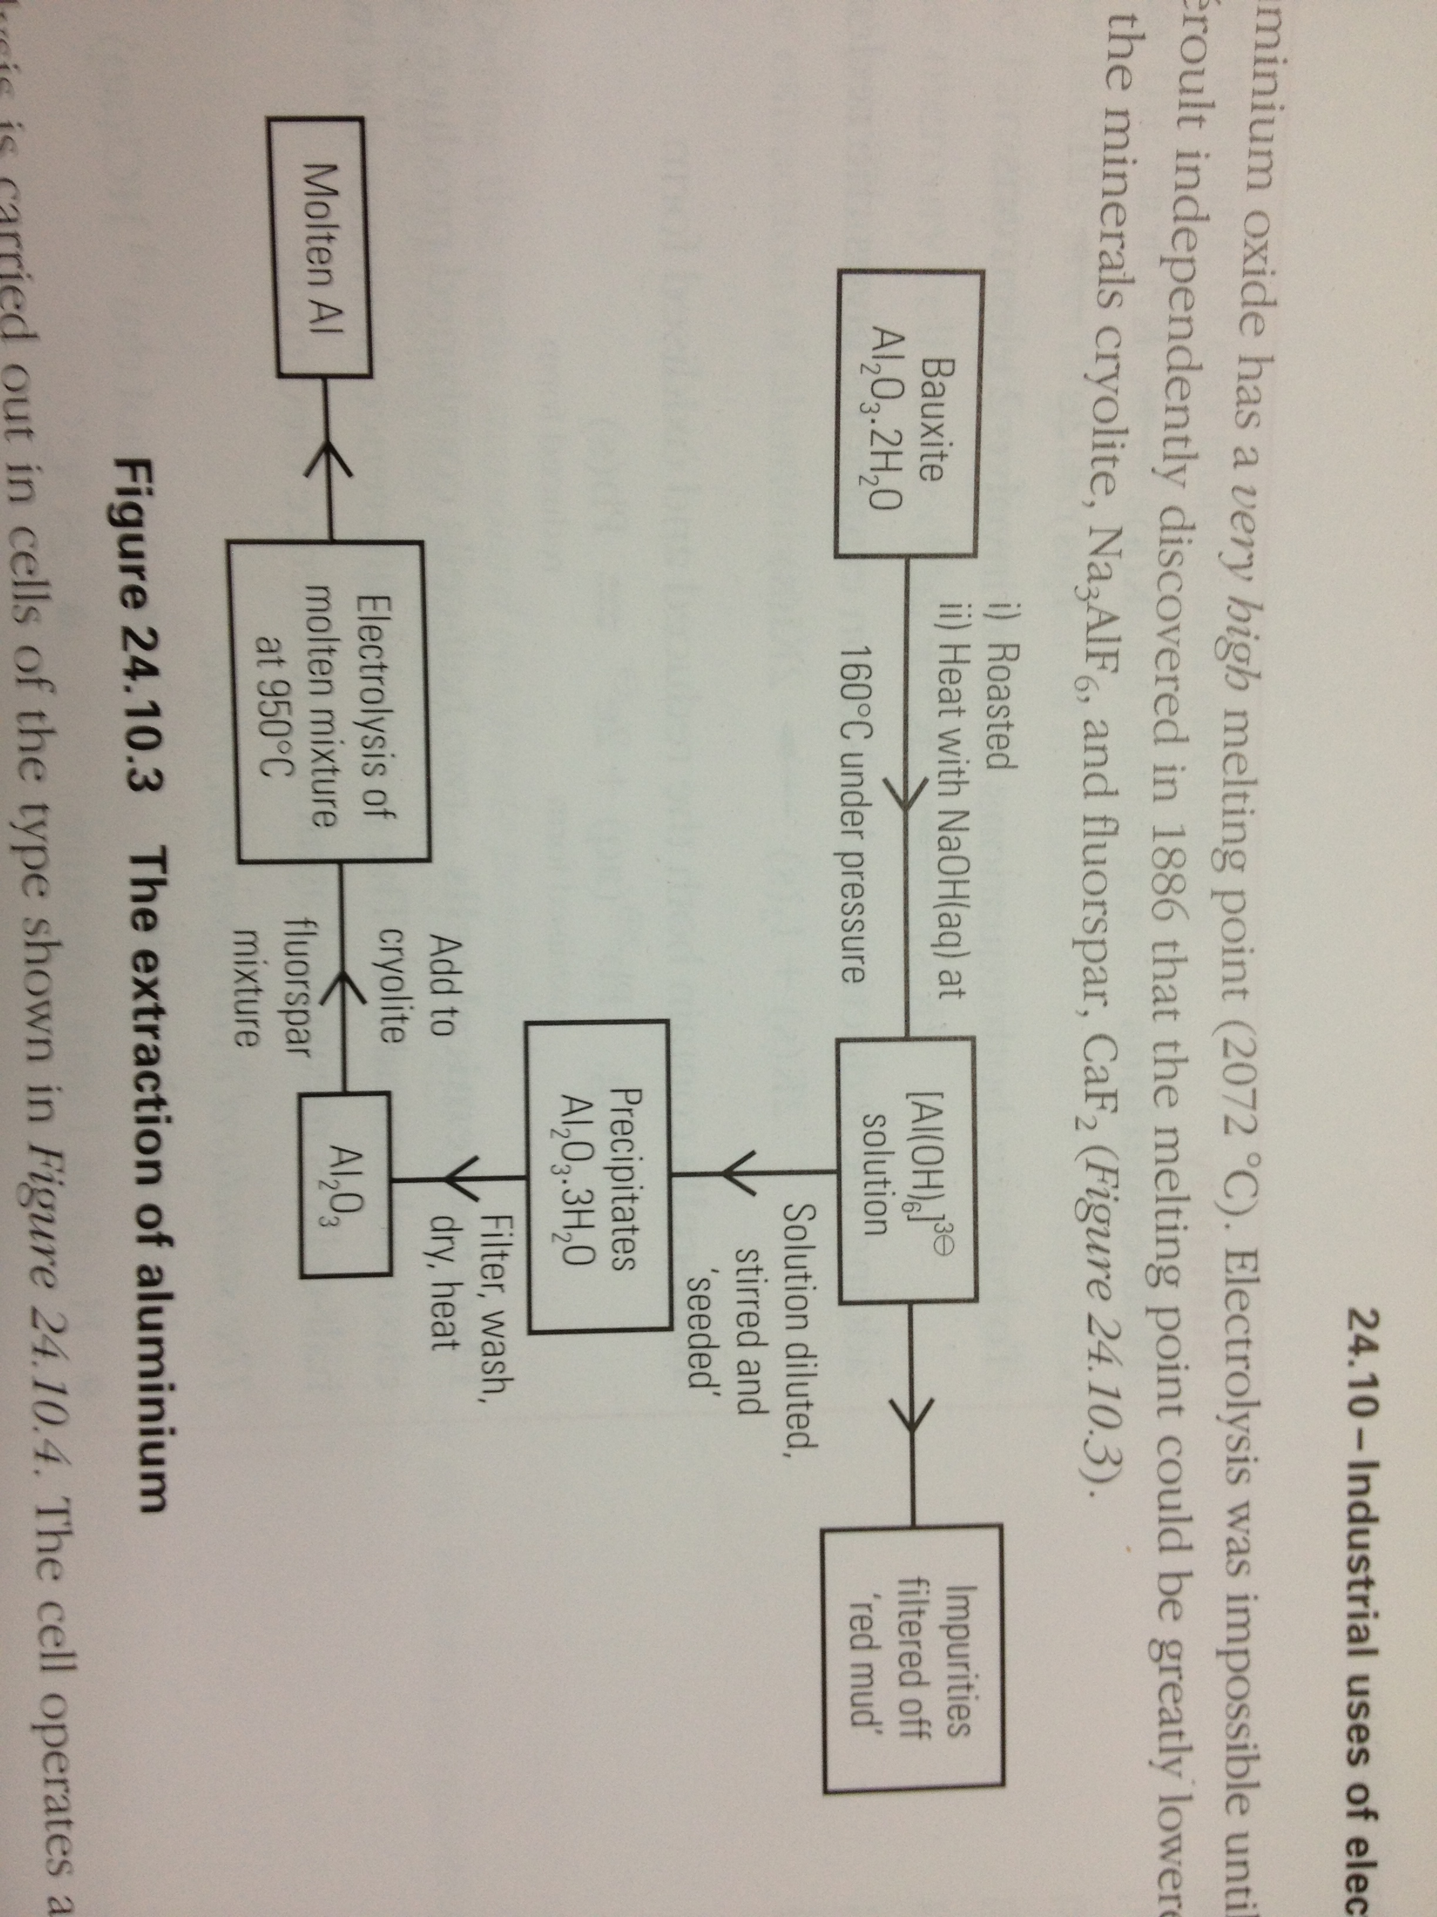

Slide 4
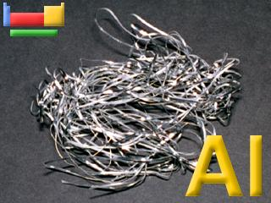
Extraction of Aluminium
Aluminium cannot be extracted from their oxides by reduction with carbon because:
It is more reactive than carbon, so the reaction does not work.
Instead, it is extracted by electrolysis. The ore is first converted into pure Aluminium oxide by the Bayer Process (involves treatment with sodium hydroxide solution, and this is then electrolysed in solution in molten cryolite - another Aluminium compound.

Slide 5
Bayer Process
Bauxite, Al₂O₃.2H₂O contains iron oxides, silicon dioxide and titanium dioxide as impurities
First roasted in air to convert iron(II) compounds to iron(III) compounds
Heated at 160ºC under pressure up to 35atm with NaOH(aq)
Al₂O₃(s) + 6OH⁻⁽aq) + 3H₂O(l) ➔ 2[Al(OH)₆]³⁻(aq)
Undissolved impurities filtered off – ‘red mud’
Remaining liquid ‘seeded’ with aluminium hydroxide
Hydrated alumina (aluminium oxide) percipitates
2[Al(OH)₆]³⁻(aq) ➔ Al₂O₃.3H₂O(s) + 6OH⁻⁽aq)
Percipitate is filtered , washed, dried and heated to give pure aluminium oxide, Al₂O₃, a white powder

Slide 6
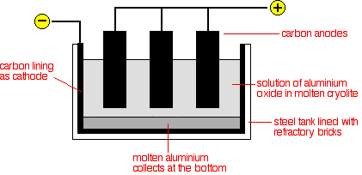
Extraction of Aluminium

Slide 7
Extraction of Aluminium
The aluminum oxide must be in molten
Aluminium oxide has a very high melting point : 2040ºC
Cryolite Na₃AlF₆ added to:
Dissolve the aluminium oxide so that the melting point of the electrolyte is lowered to about 970ºC
Improve the electrical conductivity of the electrolyte
When a current of 12 000A at a voltage of 5V is applied,
Al³⁺ is attracted to the cathode (negative electrode)
O²⁻ is attracted to the anode (positive electrode)

Slide 8
Half-Equation
At the cathode,
Al³⁺ gains 3 electrons at the cathode and are reduced to aluminium atoms
Al³⁺(l) + 3e⁻ ➔ Al (l)
The denser Al drops to the bottom of the cell and removed using a suction tube or through a tap hole
At the anode,
O²⁻ loses 2 electrons at the anode and are oxidised to form oxygen
2O²⁻(l) ➔ O₂(g) + 4e⁻
Oxygen reacts with hot carbon electrodes to give CO₂ gas. Thus, the electrodes have to be replaced periodically

Slide 9
Overall Equation
4Al³⁺ + 12e⁻ ➔ 4Al
6O²⁻ ➔ 3O₂ + 12e⁻
Overall equation:
4Al³⁺ + 6O²⁻ ➔ 4Al + 3O₂
_{Or}
2Al₂O₃ ➔ 4Al + 3O₂

Slide 10
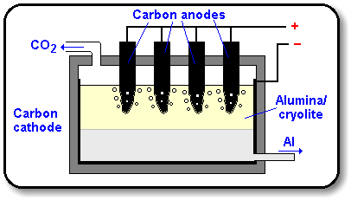

Slide 11
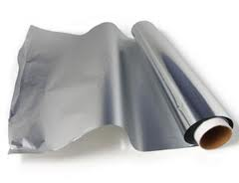
Aluminium
Aluminium is especially useful because it
has a low density;
is strong when alloyed;
is a good conductor of electricity;
has a good appearance;
resists corrosion because of the strong thin layer of aluminium oxide on its surface.
Aluminium is used for aircraft, trains, overhead power cables, saucepans and cooking foil

Slide 12
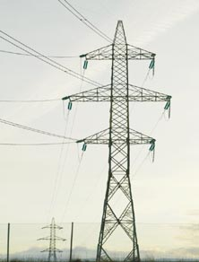
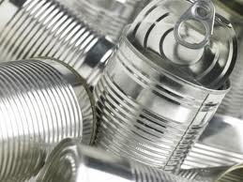
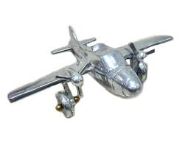
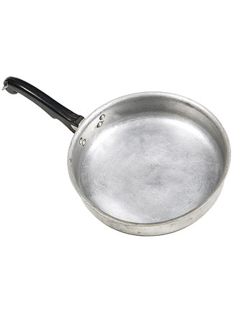
Uses of Aluminium
Uses | Properties
Overhead electric cables | Low density, Light Resistant to corrosion Good electrical conductivity
Food containers | Non-toxic Resistant to corrosion Light
Aircraft body | Low density Light High tensile strength Resistant to corrosion
Saucepans | Light Resists corrosion Good appearance Good conductor of heat

Slide 13
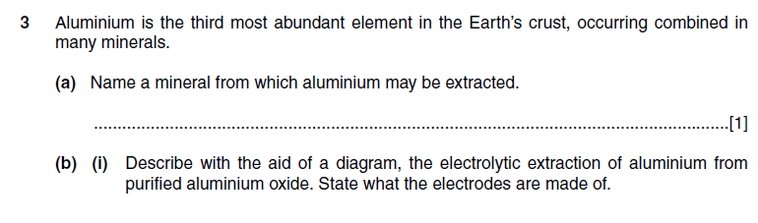
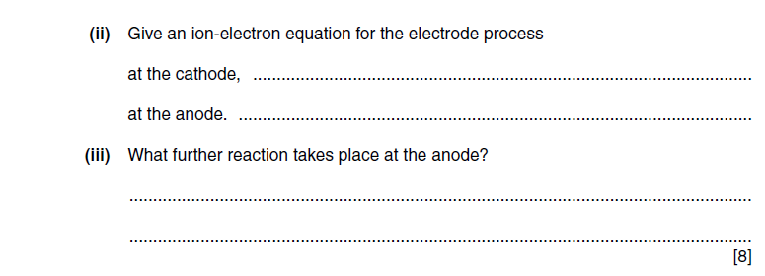
PAST YEAR QUESTIONS MAY / JUNE 2002

Slide 14
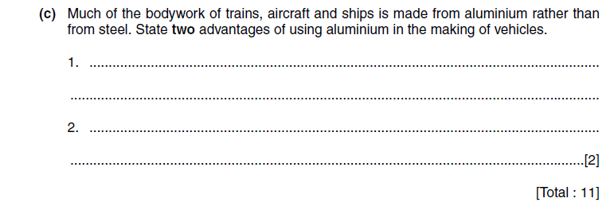

Slide 15
THE END THANK YOU :D

